Slide 1
MBTA Communities Zoning Requirements
Belmont Planning Division

Slide 2
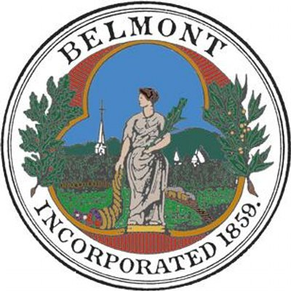
What is the MBTA Communities Legislation?
Enacted as part of the economic development bill in January 2021, a new Section 3A of M.G.L. c. 40A (the Zoning Act) requires that an MBTA community shall have at least 1 zoning district of reasonable size in which multi-family housing (three or more units) is permitted “as of right” and meets other criteria set forth in the statute:
Minimum gross density of 15 units per acre
Not more than ½ miles from a commuter rail station, subway station, ferry terminal or bus station, if applicable.
No age restrictions
Suitable for families with children.
Cities that do not comply with the new requirements will be ineligible for
MassWorks, Housing Choice, and Local Capital Projects funds.
MBTA Communities Zoning Requirements

Slide 3
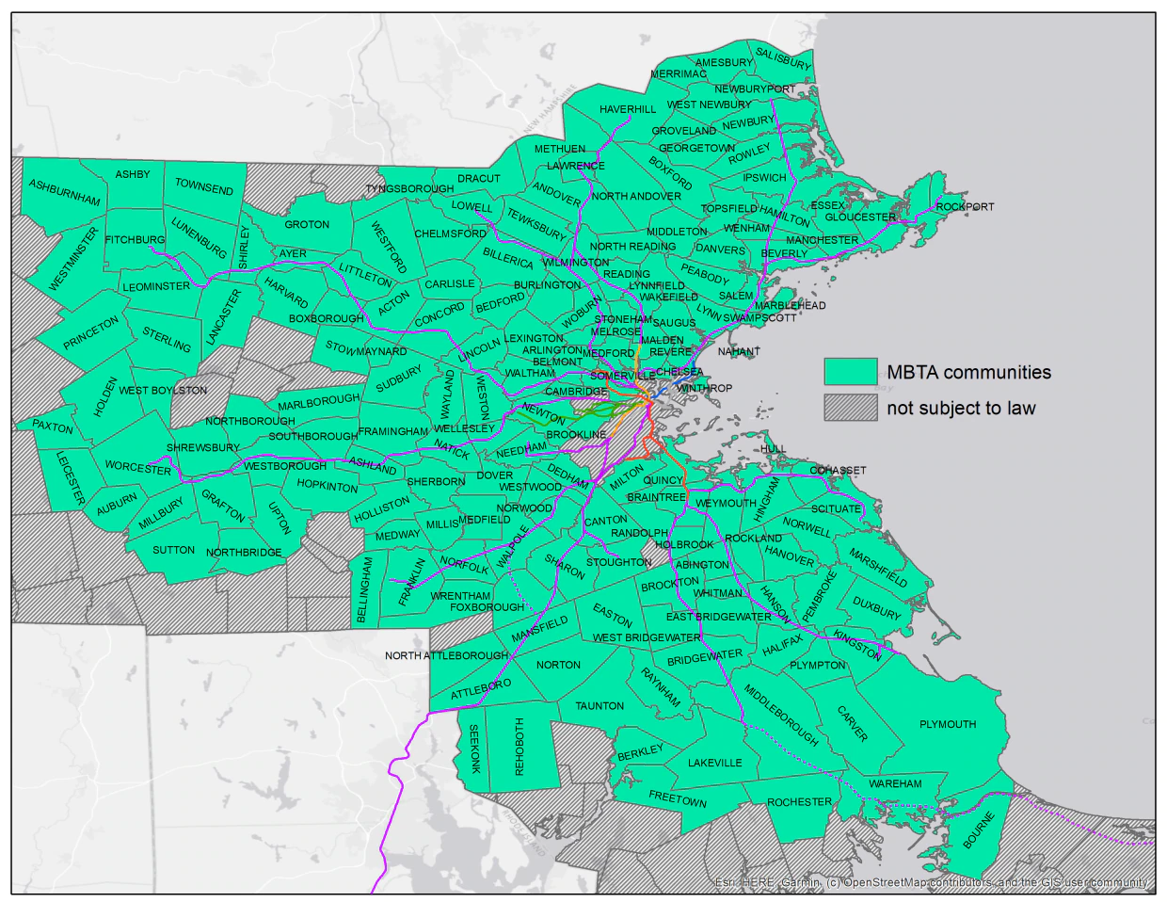
Belmont

Slide 4
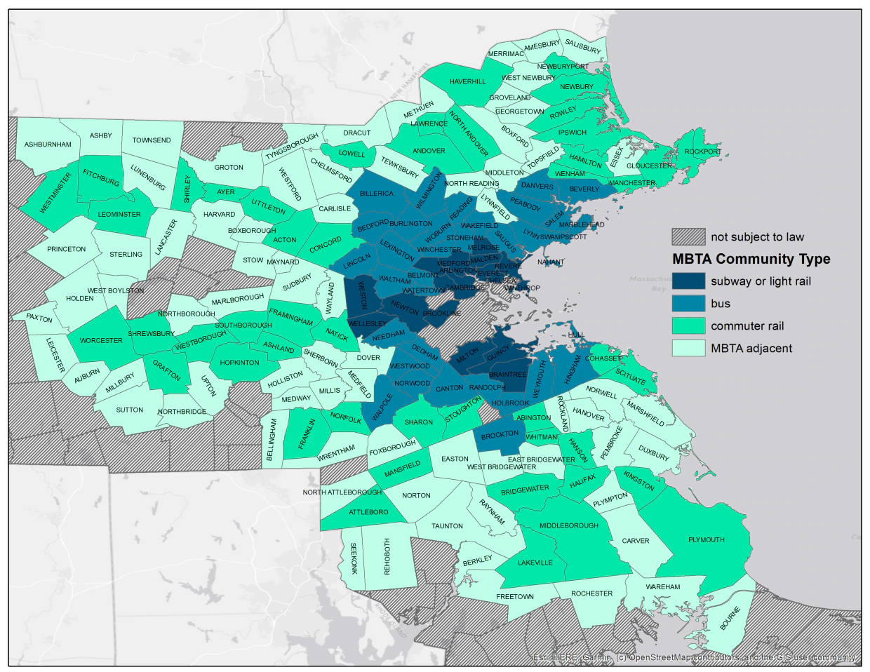
Belmont

Slide 5
Guidance on Compliance
Section 3A instructed the Department of Housing and Community Development (DHCD), in consultation with the MBTA and the Department of Transportation, to develop guidelines for how cities can comply with the new zoning requirements.
These guidelines provide clarity to the legislation, including:
What it means to permit multi-family housing “as of right”
What is a district of “reasonable size”
How to determine if a multi-family district has a minimum gross density of 15 units per acre
The meaning of Section 3A’s mandate that “such multi-family housing shall be without age restrictions and shall be suitable for families with children”
The extent to which MBTA communities have flexibility to choose the location of a multifamily district
DHCD issued draft guidance on December 15, 2021.
Town of Belmont - Planning Division
MBTA Communities Zoning Requirements

Slide 6
Highlights of DHCD Guidelines
As of right
“…the construction and occupancy of multi-family housing is allowed in that district without the need to obtain any discretionary permit or approval.” Site Plan Review may be required but may not be used to deny a project. No Special Permit requirement.
As of right can include mixed-use
Reasonable size
Minimum land area: “at least 50 acres of land - or approximately one-tenth of the land area within 0.5 mile of a transit station.”
Overlay districts allowed with certain conditions
Minimum multifamily unit capacity: “A compliant district’s multi-family unit capacity must be equal to or greater than a specified percentage of the total number of housing units within the community.”
Category | Minimum multi-family units as a % of total housing stock
Rapid Transit Community | 25%
Bus Service Community | 20%
Commuter Rail Community | 15%
Adjacent Communities | 10%
MBTA Communities Zoning Requirements

Slide 7
What this means for Belmont
Belmont is considered a Bus Service Community
According to the 2020 Census, Belmont currently has 10,882 housing units
This means that to comply with Section 3A, Belmont must establish one (or more) as of right
zoning districts that total at least 50 acres and have a zoned capacity for 2,176 units
Belmont is not mandated to build this many units - only to create zoning districts that allow for them.
Multiple zoning districts may be used to comply, as long as they meet Section 3A’s criteria
Belmont has multiple train stations and bus line which provides more flexibility for zoning district locations
MBTA Communities Zoning Requirements

Slide 8
Effects of Non-Compliance
Cities that do not comply with the new requirements will be ineligible for
MassWorks, Housing Choice, and Local Capital Projects funds.
DHCD may, at its discretion, take noncompliance into consideration when making other discretionary grant awards.
MBTA Communities Zoning Requirements

Slide 9
Timeline for Evaluation and Compliance
April 2022 May 2, 2022 May - December, 2022
Hold a briefing with the Select Board on the Draft Compliance Guidelines.
Submit MBTA Community Information Form to DHCD.
Evaluate zoning and determine compliance (or non-compliance)
December 31, 2022
March 31, 2023
December 31, 2023
If existing zoning complies: Apply for Determination of Compliance
If non-compliant: Have DHCD approve an Action Plan of how Belmont will come into compliance; this includes timeframes and deadlines for adopting zoning.
Adopt zoning amendments by the dates specified in the Action Plan.
Request determination of full compliance from DHCD.
If existing zoning does not comply: Notify DHCD of non-compliance
MBTA Communities Zoning Requirements

Slide 10
Is Belmont Compliant?
No
Next Steps
Submit MBTA Community Information Form to DHCD
Begin evaluation of Belmont’s zoning
MBTA Communities Zoning Requirements

Slide 11
Available Resources for Belmont
Available Resources for Belmont
There are a range of technical resources available to assist MBTA communities to respond to the guidelines. These include:
1. Mass Housing Partnership
2. One Stop for Growth Grant Program
3. Local Assistance Program (TAP) Funding from MAPC
MBTA Communities Zoning Requirements

Slide 12
Questions?
Robert Hummel
Senior Planner
rhummel@belmont-ma.gov
617-993-2666
MBTA Communities Zoning Requirements

