Slide 1
Belmont
Age Friendly Action Committee
Outdoor Spaces

Slide 2
Age Friendly Action Committee Outdoor Spaces Goal –Establish a process to incorporate “age friendly” elements in Belmont outdoor spaces.

Slide 3
Age Friendly, Outdoor Spaces Approach/ process: What we mean by age friendly- inclusive and easy access and participation for all ages from 0 – 100 for those walking and wheeling.

Slide 4
A 5-prong approach:
Communicate the specific age friendly elements with senior citizens, town officials, town committees and employees: Recreation commission, COA Board, DPW, CPC, Community path etc.
Incorporate age friendly features in existing processes when possible
Ask for AFAC representation in existing groups
Approving programs: Consider having AFAC rep on the recreation commission, possibly CPC
Sponsor AFAG – Outdoor projects
Recommendation:
Recreation Commission to:
ask each group requesting approval to include an AFAC representative
provide requesting group with the age friendly checklist.
AFAC to:
Get the list of current projects underway and add an AFAC representative in their public meetings.
Invite them to have their public meeting at the Beech Street Center. (e.g. the Community Path Project held public meeting)

Slide 5
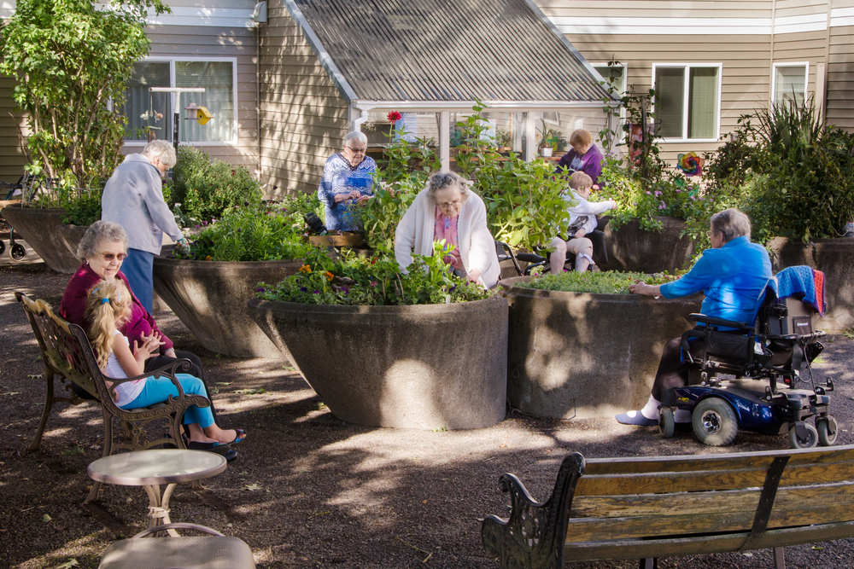
Age Friendly Features
Adjustments and adaptations that help seniors feel safe and secure in the community.
Provision of services within walking distance of where many seniors live.
Walkable sidewalk, curbs, pathways, and trails
Maintained walkways – leaves, snow, ice removal
Good accessibility to and within public buildings; (e.G., Few stairs, wheelchair ramps that are not too steep, accessible washrooms)
Appropriately timed cross-walks
Along footpaths - rest areas, including benches that are an appropriate height; accessible washrooms (e.g., Wide push-button doors, rails).

Slide 6
Barriers include . . . 1. Lack of and/or poor quality of sidewalks, curbs, and crosswalks 2. Crosswalks incorrectly timed. 3. Seasonal factors that reduce walkability and "scooter-ability" (e.g. Leaves, Snow, ice, *lack of enforcement) 4. Poor accessibility to and within public buildings
5. Shortage of accessible washrooms and rest areas along common walking areas/routes

Slide 7
Checklist of Age-Friendly Features - Outdoor Spaces
Sidewalks, pathways and trails are well-maintained, cleared, non-slip and accessible.
Sidewalks are continuous, with low curbs that accommodate wheelchairs and scooters.
Snow removal is prompt and considerate of seniors (e.g. Consideration is given to how snow is piled for those who need to get in and out of cars, and that seniors may be in wheelchairs or using scooters – particularly at major commercial intersections).
Parking lots are well-maintained and cleared of snow and ice.
Streets are well-maintained.
Rain (and Sun) shelters are available to support pedestrians.
Public washrooms are accessible and can accommodate people with a variety of disabilities (accommodations include push buttons, wide doors, handrails, locks that are easy for those with arthritis to use) and are located at convenient locations with proper signage.
Accessible benches (the appropriate height for seniors) are located along sidewalks, paths or trails and are spaced at regular intervals.
Safety and security:
Neighborhoods and trails are well-lit.
Traffic volumes are low and/or well-controlled.

Slide 8
Suggestions for improving Age Friendliness . . .
1. Provide intergenerational outdoor activities to foster socialization between younger and older members of the community and assist those with mobility problems. 2. Set up indoor walking clubs for periods of poor weather conditions. 3. Post signage indicating the location of public restrooms. 4. Provide good lighting throughout neighborhoods and on trails. 5. Review and update town wide bylaws to incorporate age friendly aspects to all future projects. 6. Neighborhood safety audits to identify specific needs in each area. 7. Set up a 311-service line to report issues

Slide 9
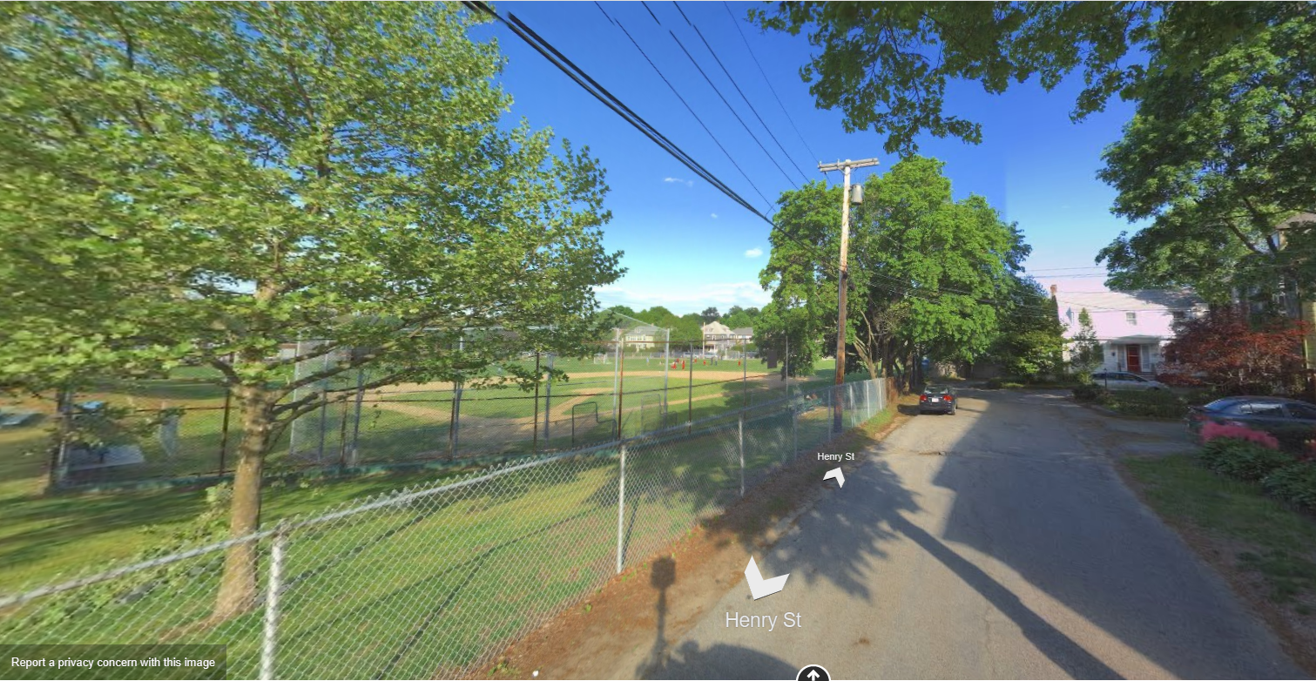
Possible Age Friendly Project: TOWN FIELD SIDEWALK
Make the sidewalk outside the town field “Age Friendly”. This could be an example of how to do it well. It could include making sure the sidewalk is appropriately smooth and maintained, make the sidewalk a circle to the senior center. It could be like a walking path for seniors (and strollers). Incorporate benches (with arms) and shade trees. Make is a direct link to Sr. Center
(where there are bathrooms).

Slide 10
Happy to Chat bench
Helps build community
Reduces Loneliness
EASY to do at no cost!!

