Slide 1
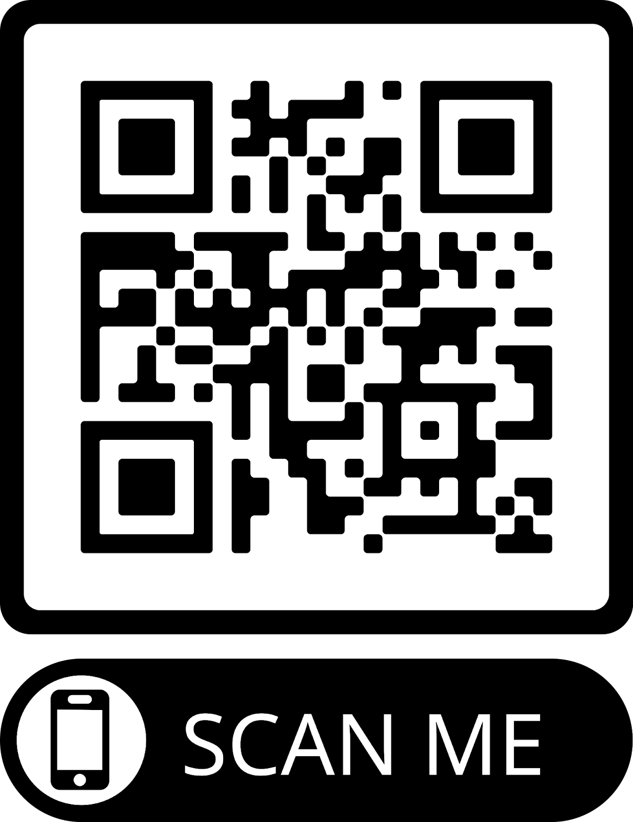
BYHA UPDATE
Thank You
What Is BYHA?
What is our role in the new rink?
Our View and Perspective
Fundraising and Awareness Campaign
Additional Community Cost Considerations
Scan to learn more and get involved!
or visit www.belmontrink.com

Slide 2
What is BYHA?
Established in 1975, Belmont Youth Hockey Association is dedicated to the character development of Belmont youth through teaching, coaching, and playing ice hockey.
Our organization is managed by a volunteer board of directors and operated by a group of more than 50 volunteer coaches. We offer programs for children between the ages of 3 and 19 and we are a member of Massachusetts Hockey’s District 9 and USA Hockey
The BYHA girls’ program is one of the fastest growing programs in the state.

Slide 3
What is BYHA?
BYHA is a pipeline to the High School programs. There are currently four Belmont High School Hockey Programs, growing from two over the last 25 years. In the last year, the programs have placed or won state championships.
Waitlist at several learn to play and skate levels and our girls and coed programs continue to grow at multiple levels. For the upcoming season 2022-2023, we have more teams than ever before at the travel level.
The number of players who will participate in BYHA this season has already surpassed last year’s total and is closing in on 500 youth.

Slide 4
Rinks Build Communities
What is our role in the new rink?
BYHA Board members and family representatives on Select Board Rink Finance Committee, the Preliminary Rink design committee and the current Rink Building Committee.
BYHA is the 501(c)(3) championing raising funds for the rink project.
Get Involved. Learn More.
visit www.belmontrink.com

Slide 5
Our View and Perspective
Timeline
20 Years
2019 Private/Public Partnership
Public Forums
Current Building Committee and Architect
Future Facility Potential
.

Slide 6
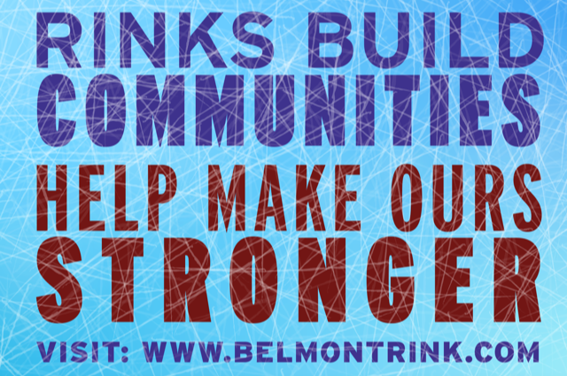
Fundraising and Awareness Campaign
Visit www.belmontrink.com

Slide 7
Fundraising and Awareness Campaign
Taking pledges for gifts over $1,000
State Funds
Currently have raised $1.625M in a few months
Events
Over 50 volunteers
Developing corporate sponsorships plan
Visit www.belmontrink.com

Slide 8
Additional Costs
Critical Safety Issues
Costs and impacts of delays and not addressing the rink:
An inoperable unsafe building, costly demolition of the rink building and White Field house
Loss of locker rooms for the field sports
Eliminating a revenue generating asset to the town
Potential consequences of injuries to community members.
Cost to maintain the very successful high school boys’ and girls’ hockey programs and impact to school budget for ice and transportation
Critical youth, recreation and community programs at risk

Slide 9
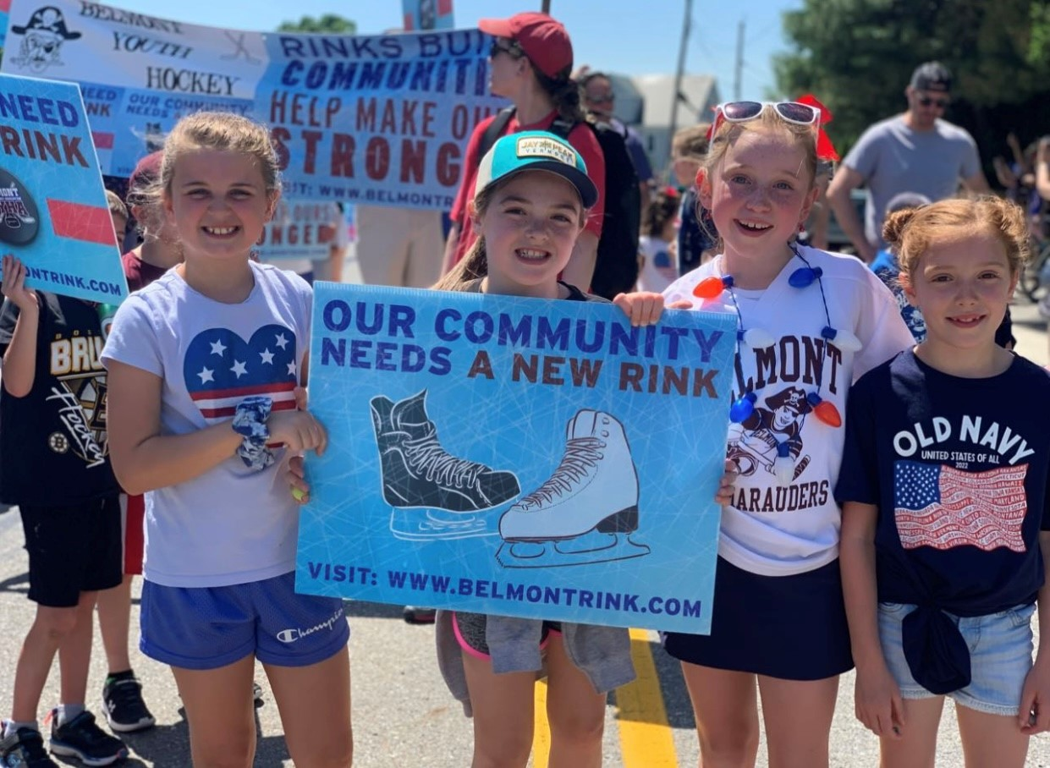
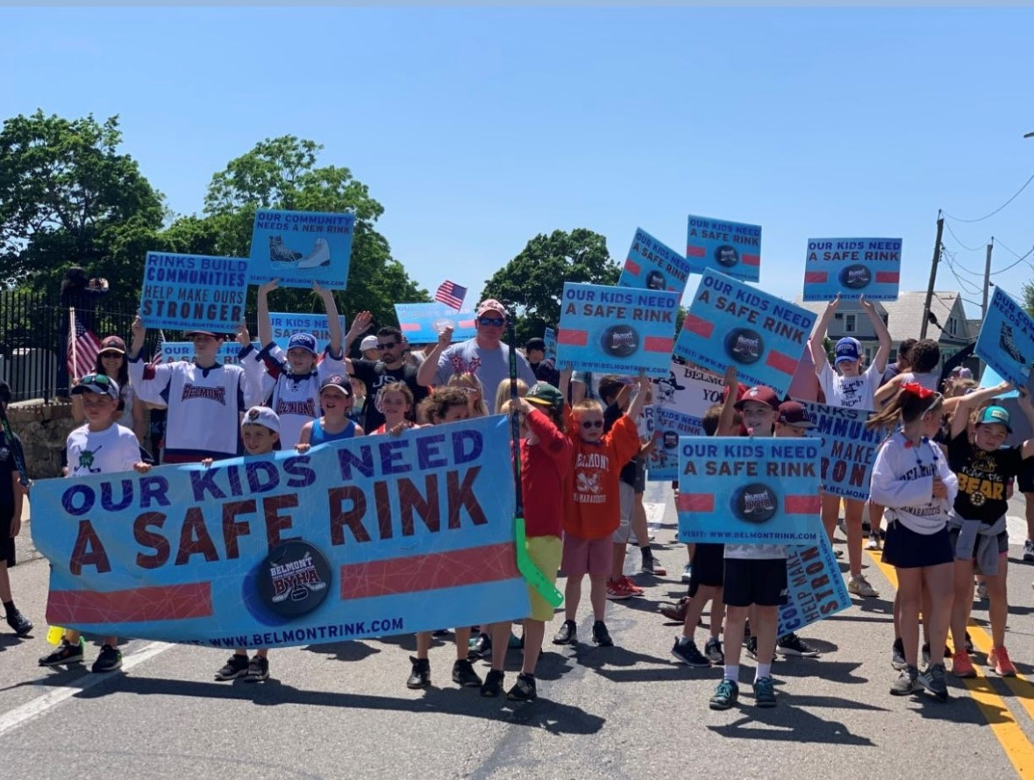
THANK YOU
Get Involved. Learn More.
Visit www.belmontrink.com

